Slide 1
Build a Watson AI Chatbot from Db2
Sanjula Ganepola
Software Developer
sanjula.ganepola@ibm.com

Slide 2
Agenda
Overview of Watsonx Assistant
Planning Your Assistant
Let’s Build a Chatbot
Integrate with Watsonx Discovery
Integrate with Db2
Next Steps

Slide 3
Overview of Watsonx Assistant

Slide 4
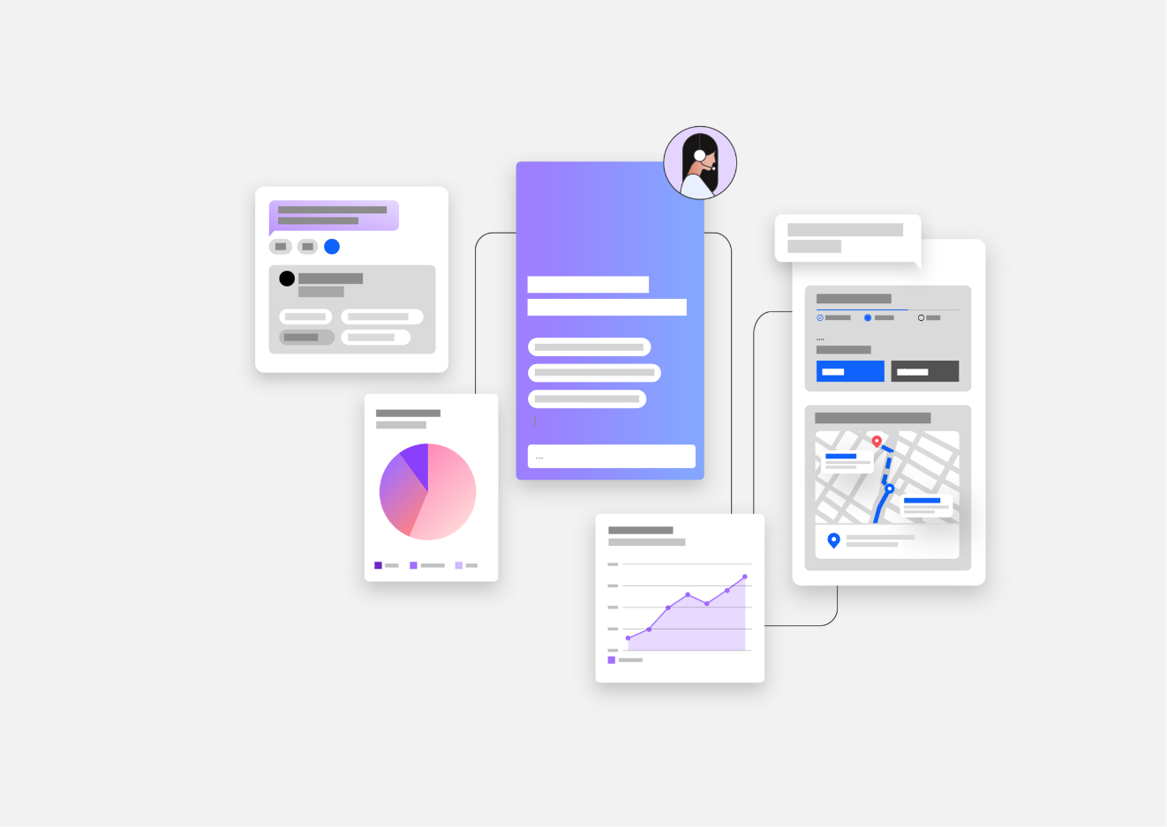
What is Watsonx Assistant?
“Conversational AI solution that empowers anyone to effortlessly build generative AI Assistants that deliver frictionless self-service experiences to customers”
↓
Use Watsonx Assistant to build your own branded live chatbot
💻 Bring the assistant to your customers, where they are
🧠 Create AI-driven conversational flows
📑 Embed existing help content
🤝 Connect to your customer service teams
🎯 Track customer engagement and satisfaction

Slide 5
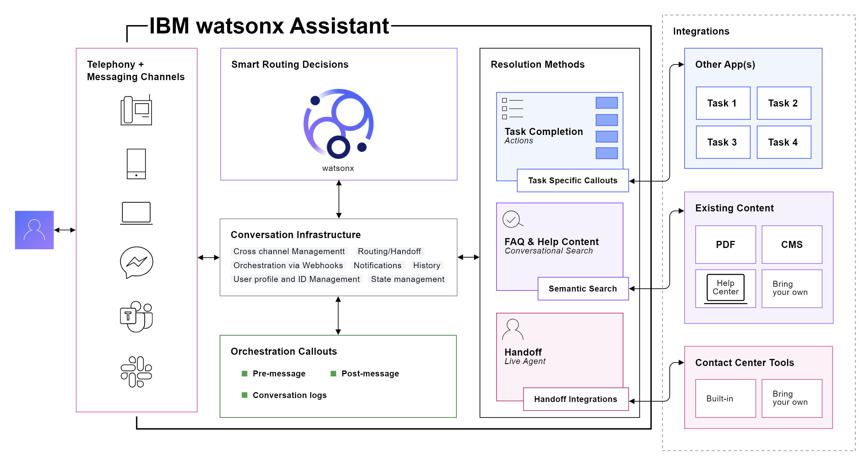
How Does It Work?

Slide 6
Planning Your Assistant

Slide 7
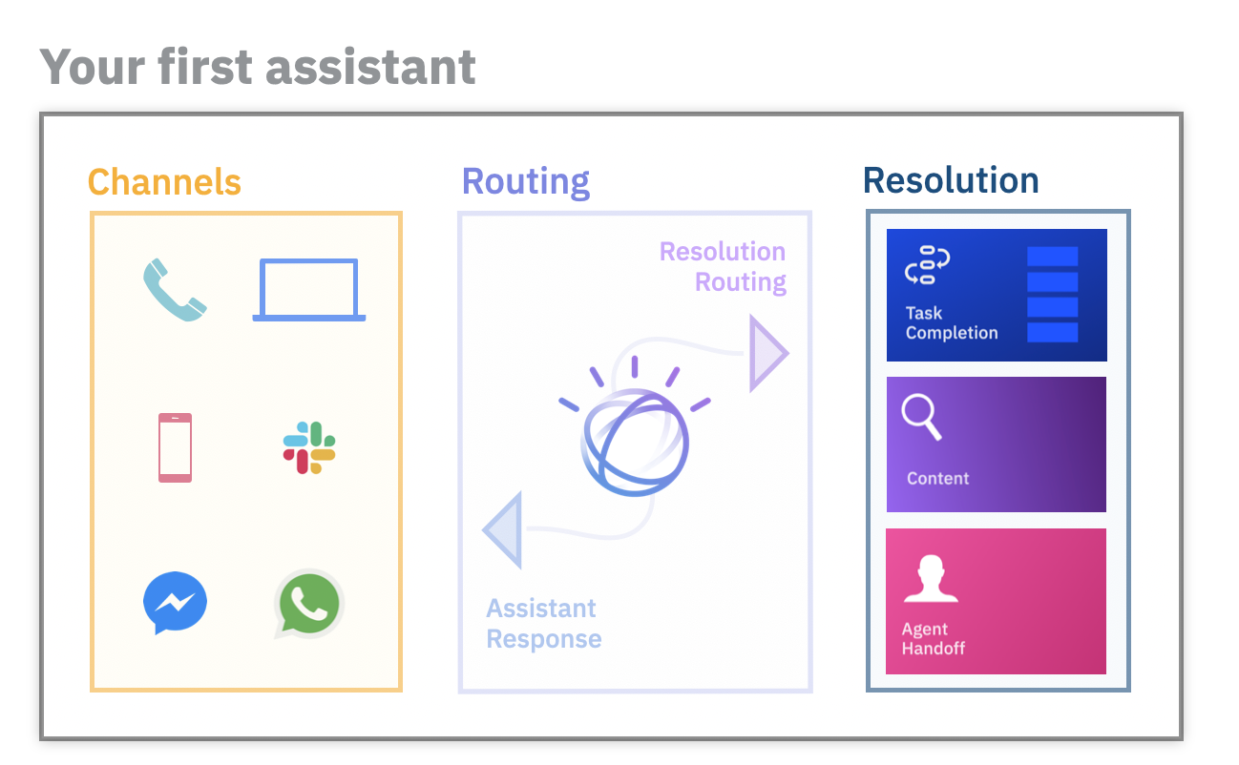
Before building an assistant…
Select an initial channel
Where will customers use your assistant?
Select starting domain
What topic domain can your assistant unify and automate?
Outline frequent topics
What are the most frequent topics which are mostly informational in nature?
Collect content sources
What help content is available to customers today?
Plan handoff strategy
How should customers be routed to human agents?

Slide 8




Demo Example – ConnectMe Inc.
ConnectMe Inc. is a telecommunications company with cable, internet, and phone services
Goals
Automate bill payments services
Update customer data in real-time
Provide 24/7 support
Improve accessibility of FAQ manuals
Plan
Select an initial channel
Easy-to-embed web chat widget
Select starting domain
ADD TEXT HERE
Outline frequent topics
ADD TEXT HERE
Collect content sources
ADD TEXT HERE
Plan handoff strategy
ADD TEXT HERE
ConnectMe Inc.
Customer A
Support Rep A
Database
Customer B
Support Rep B
FAQ Manual

Slide 9
Let’s Build a Chatbot

Slide 10
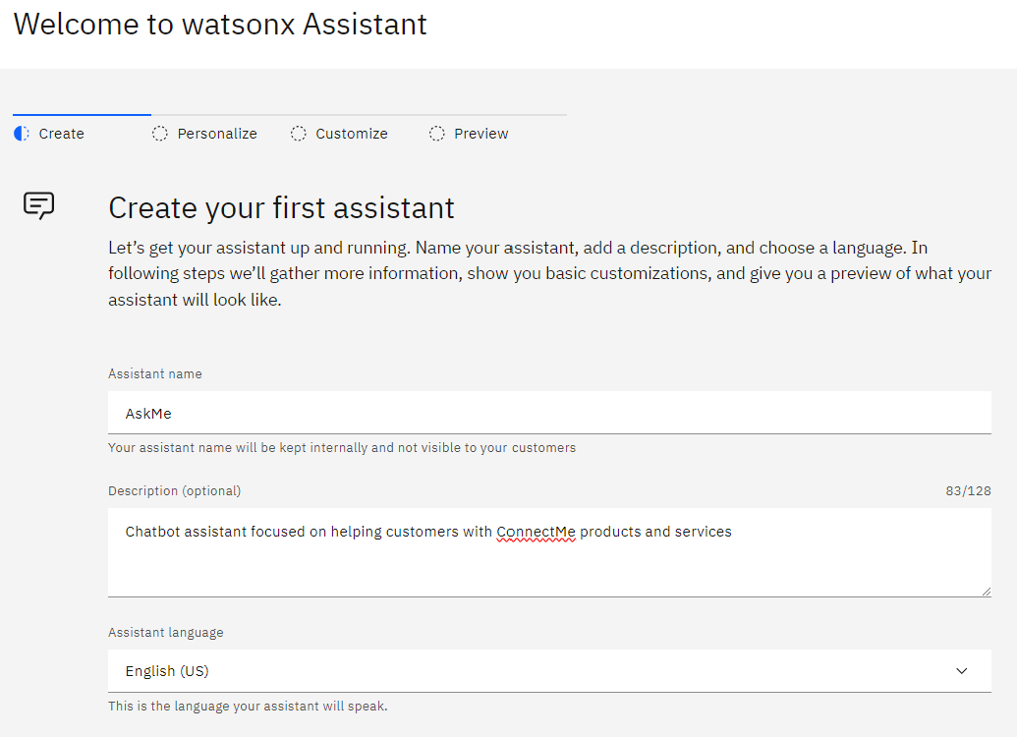
Create Watsonx Assistant

Slide 11
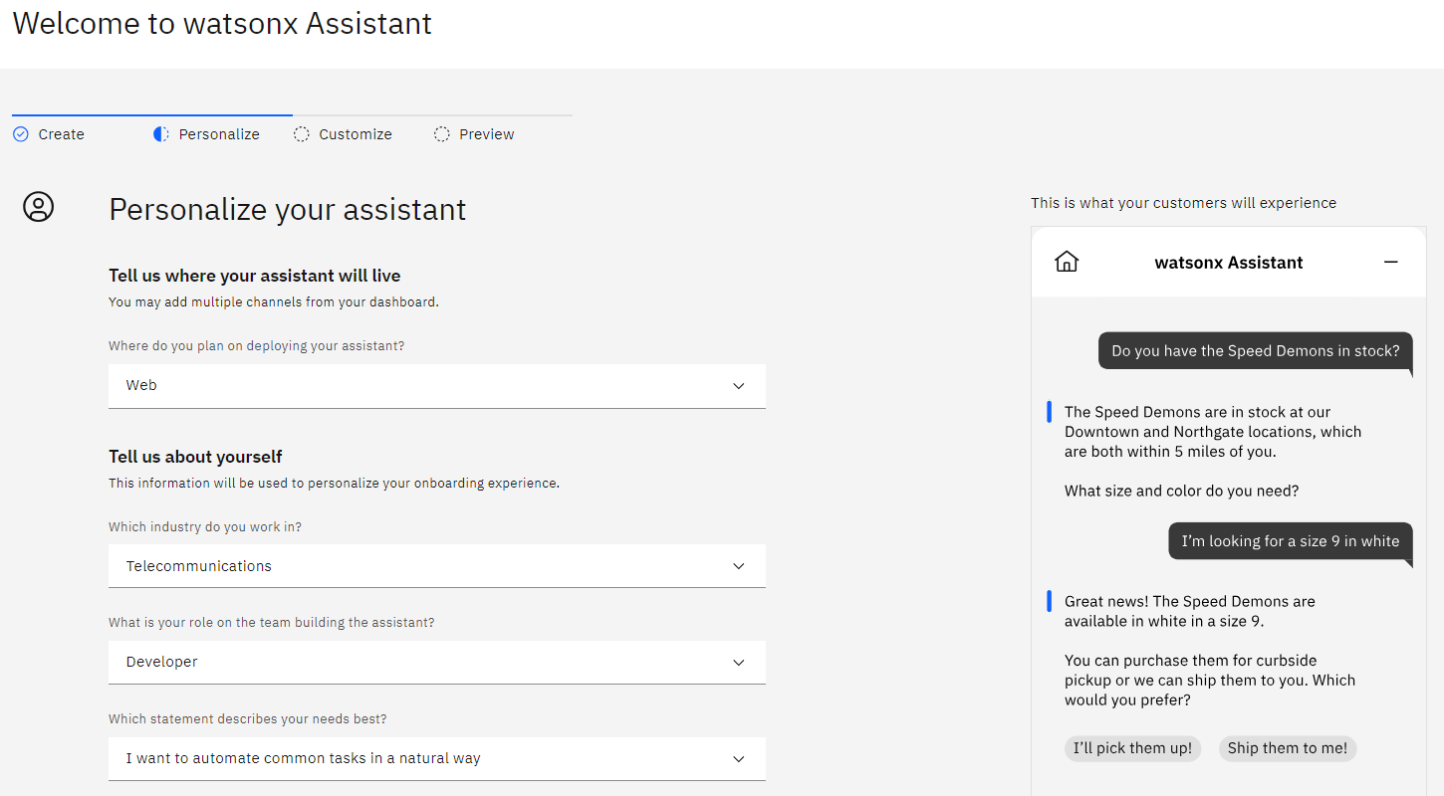
Personalize Your Assistant

Slide 12
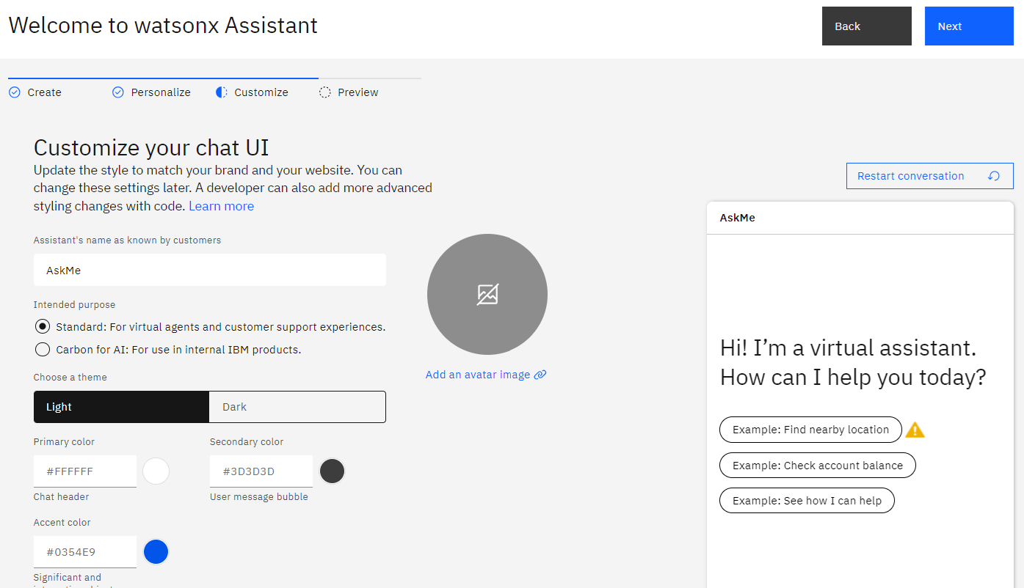
Customize Your Chat UI

Slide 13
Create an Action

Slide 14
Add Conversational Steps

Slide 15
Add Conversational Steps

Slide 16
AAAAA

Slide 17
AAAAA

Slide 18
AAAAA

Slide 19
Integrate with Watsonx Discovery

Slide 20
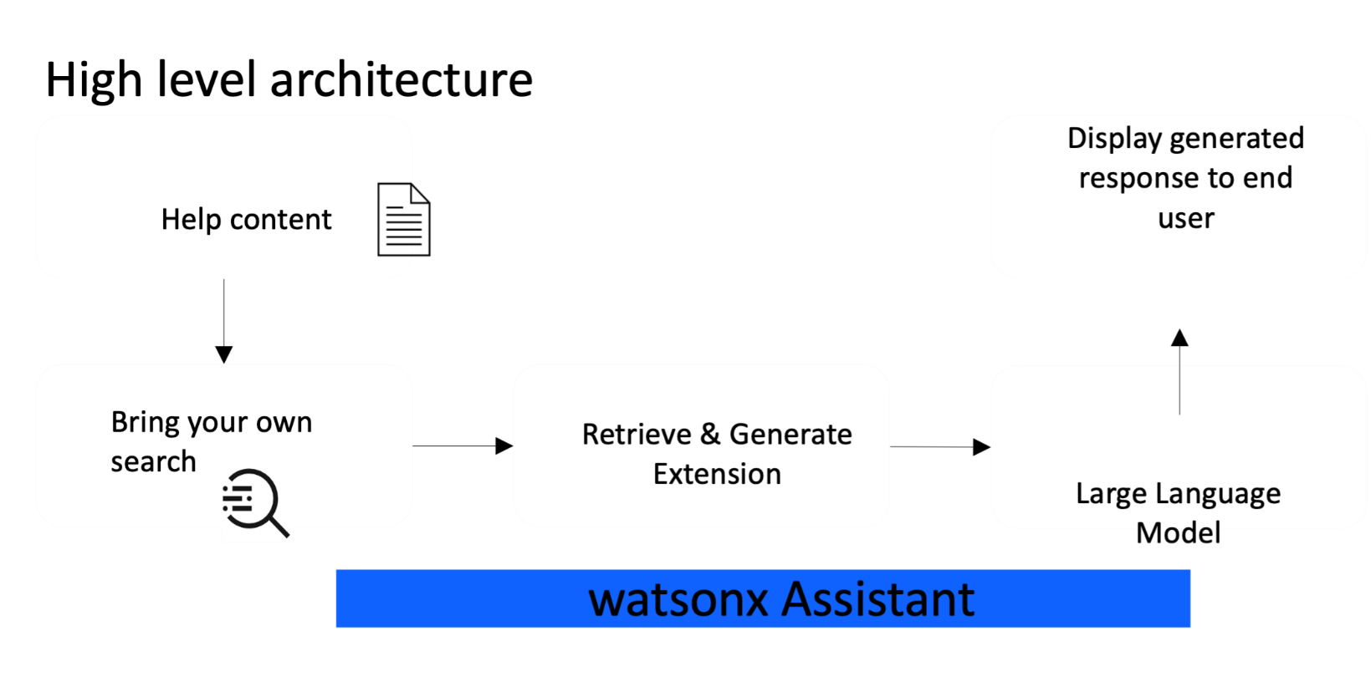
AAAAA

Slide 21
AAAAA

Slide 22
Integrate with Db2

Slide 23
AAAAA

Slide 24
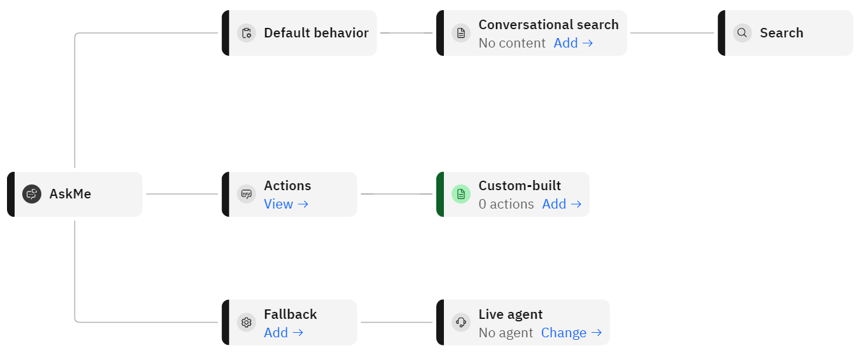
Assistant Architecture

Slide 25
Next Steps

Slide 26
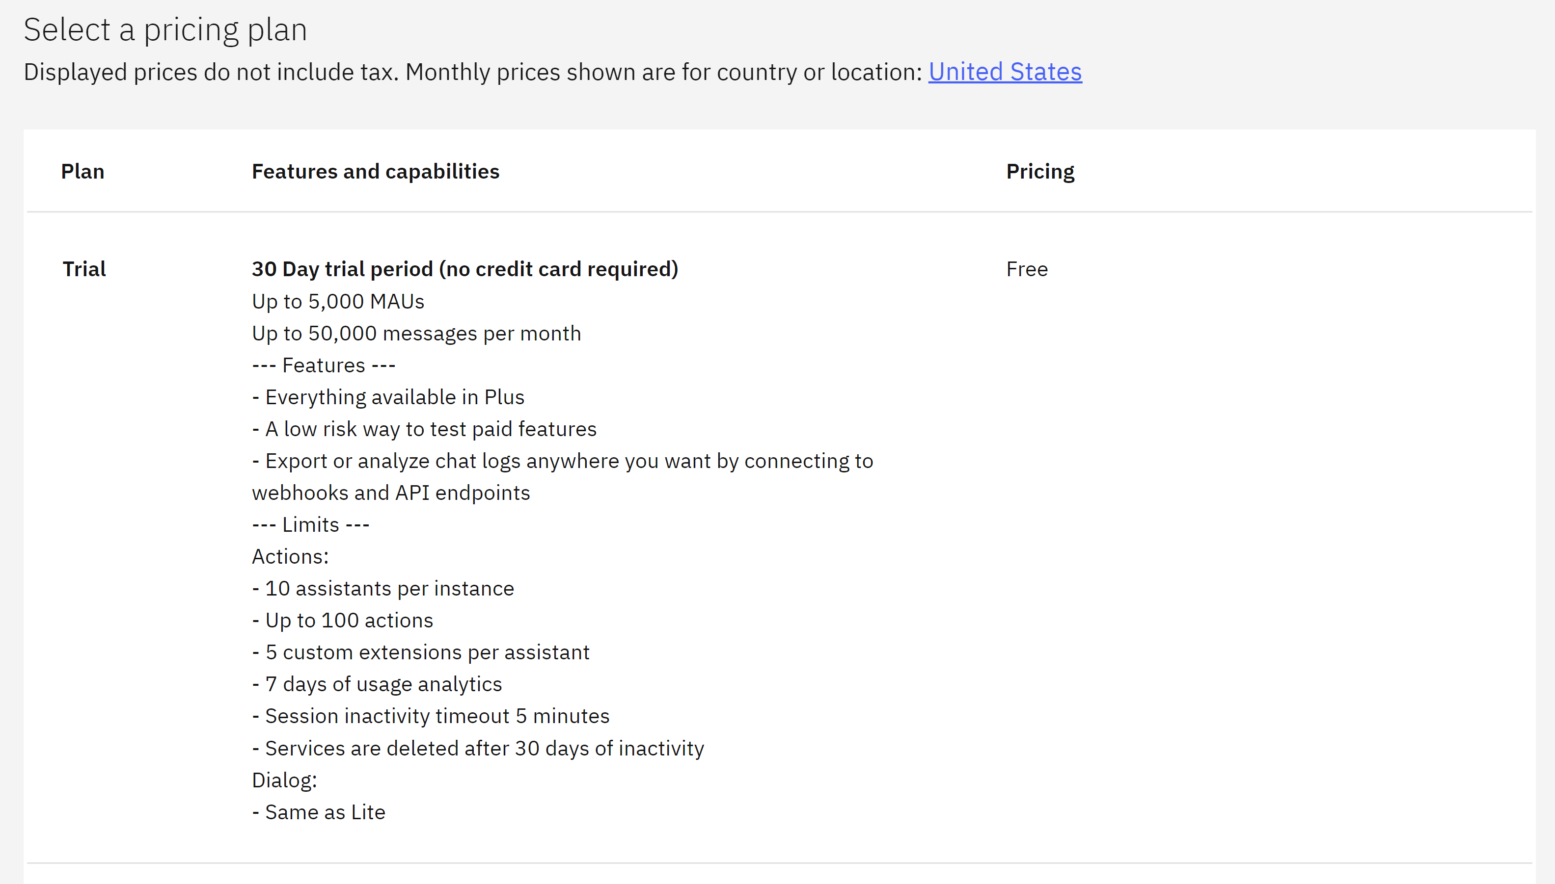
30 Day Free Trial!

Slide 27
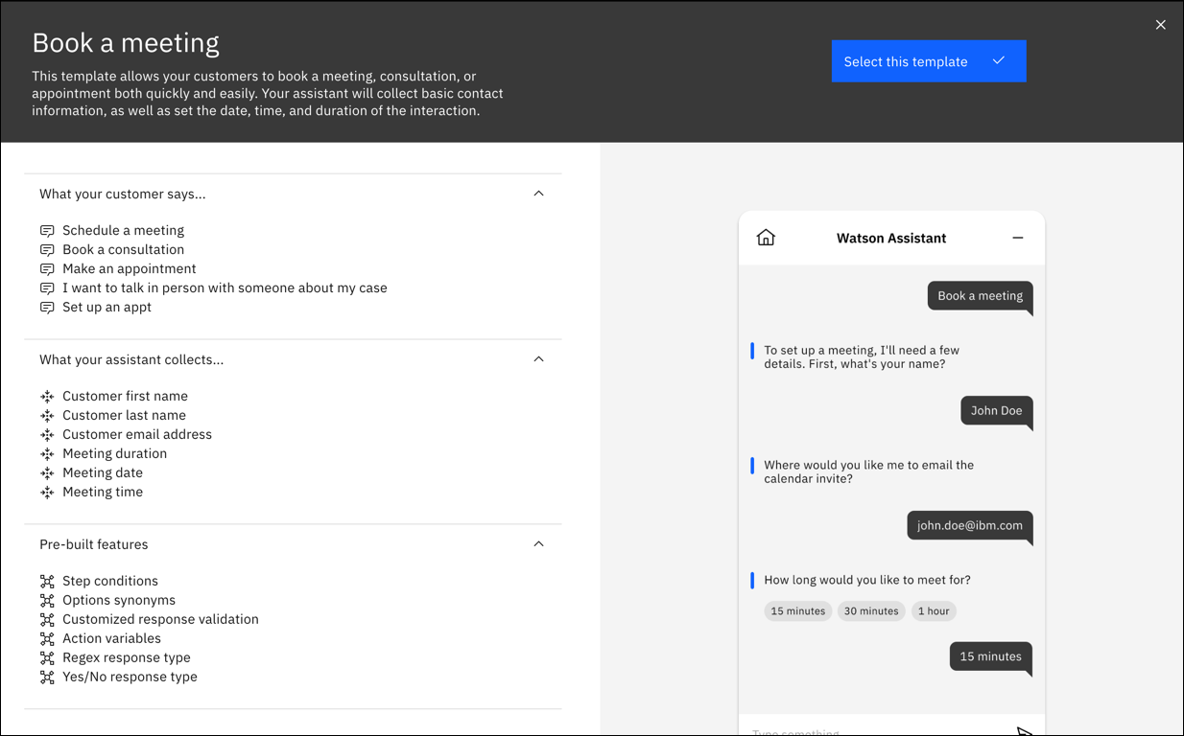
Quick Start With Templates

Slide 28
Any Questions?

Slide 29
Important Links
IBM Watsonx Assistant
Documentation https://cloud.ibm.com/docs/watson-assistant
B B

Slide 30

For More Information
Links You Need | Twitter | #Hashtags
IBM i Home Page: https://www.ibm.com/it-infrastructure/power/os/ibm-i (find link to Forrester Study and updated IBM i Strategy Whitepaper) IBM Strategy Whitepaper: https://www.ibm.com/it-infrastructure/us-en/resources/power/i-strategy-roadmap/ IBM Client Success: https://www.ibm.com/it-infrastructure/us-en/resources/power/ibm-i-customer-stories/ Support Life Cycle: https://www.ibm.com/support/lifecycle/ License Topics: https://www-01.ibm.com/support/docview.wss?uid=nas8N1022087 Fortra IBM i Marketplace Survey https://www.fortra.com/resources/guides/ibm-i-marketplace-survey-results | @IBMSystems @COMMONug @IBMChampions @IBMSystemsISVs @IBMiMag @ITJungleNews @SAPonIBMi @SiDforIBMi | #PowerSystems #IBMi #IBMAIX #POWER9 #LinuxonPower #OpenPOWER #HANAonPower #ITinfrastructure #OpenSource #HybridCloud #BigData

